Slide 1
COMPONENT LIBRARIES AND FLUENTUI
https://github.com/tnt-summer-academy/Curriculum-2022/blob/main/Week%204/%5BENG4.0%5DComponent%20libraries.md
Created for Microsoft / TNTs

Slide 2
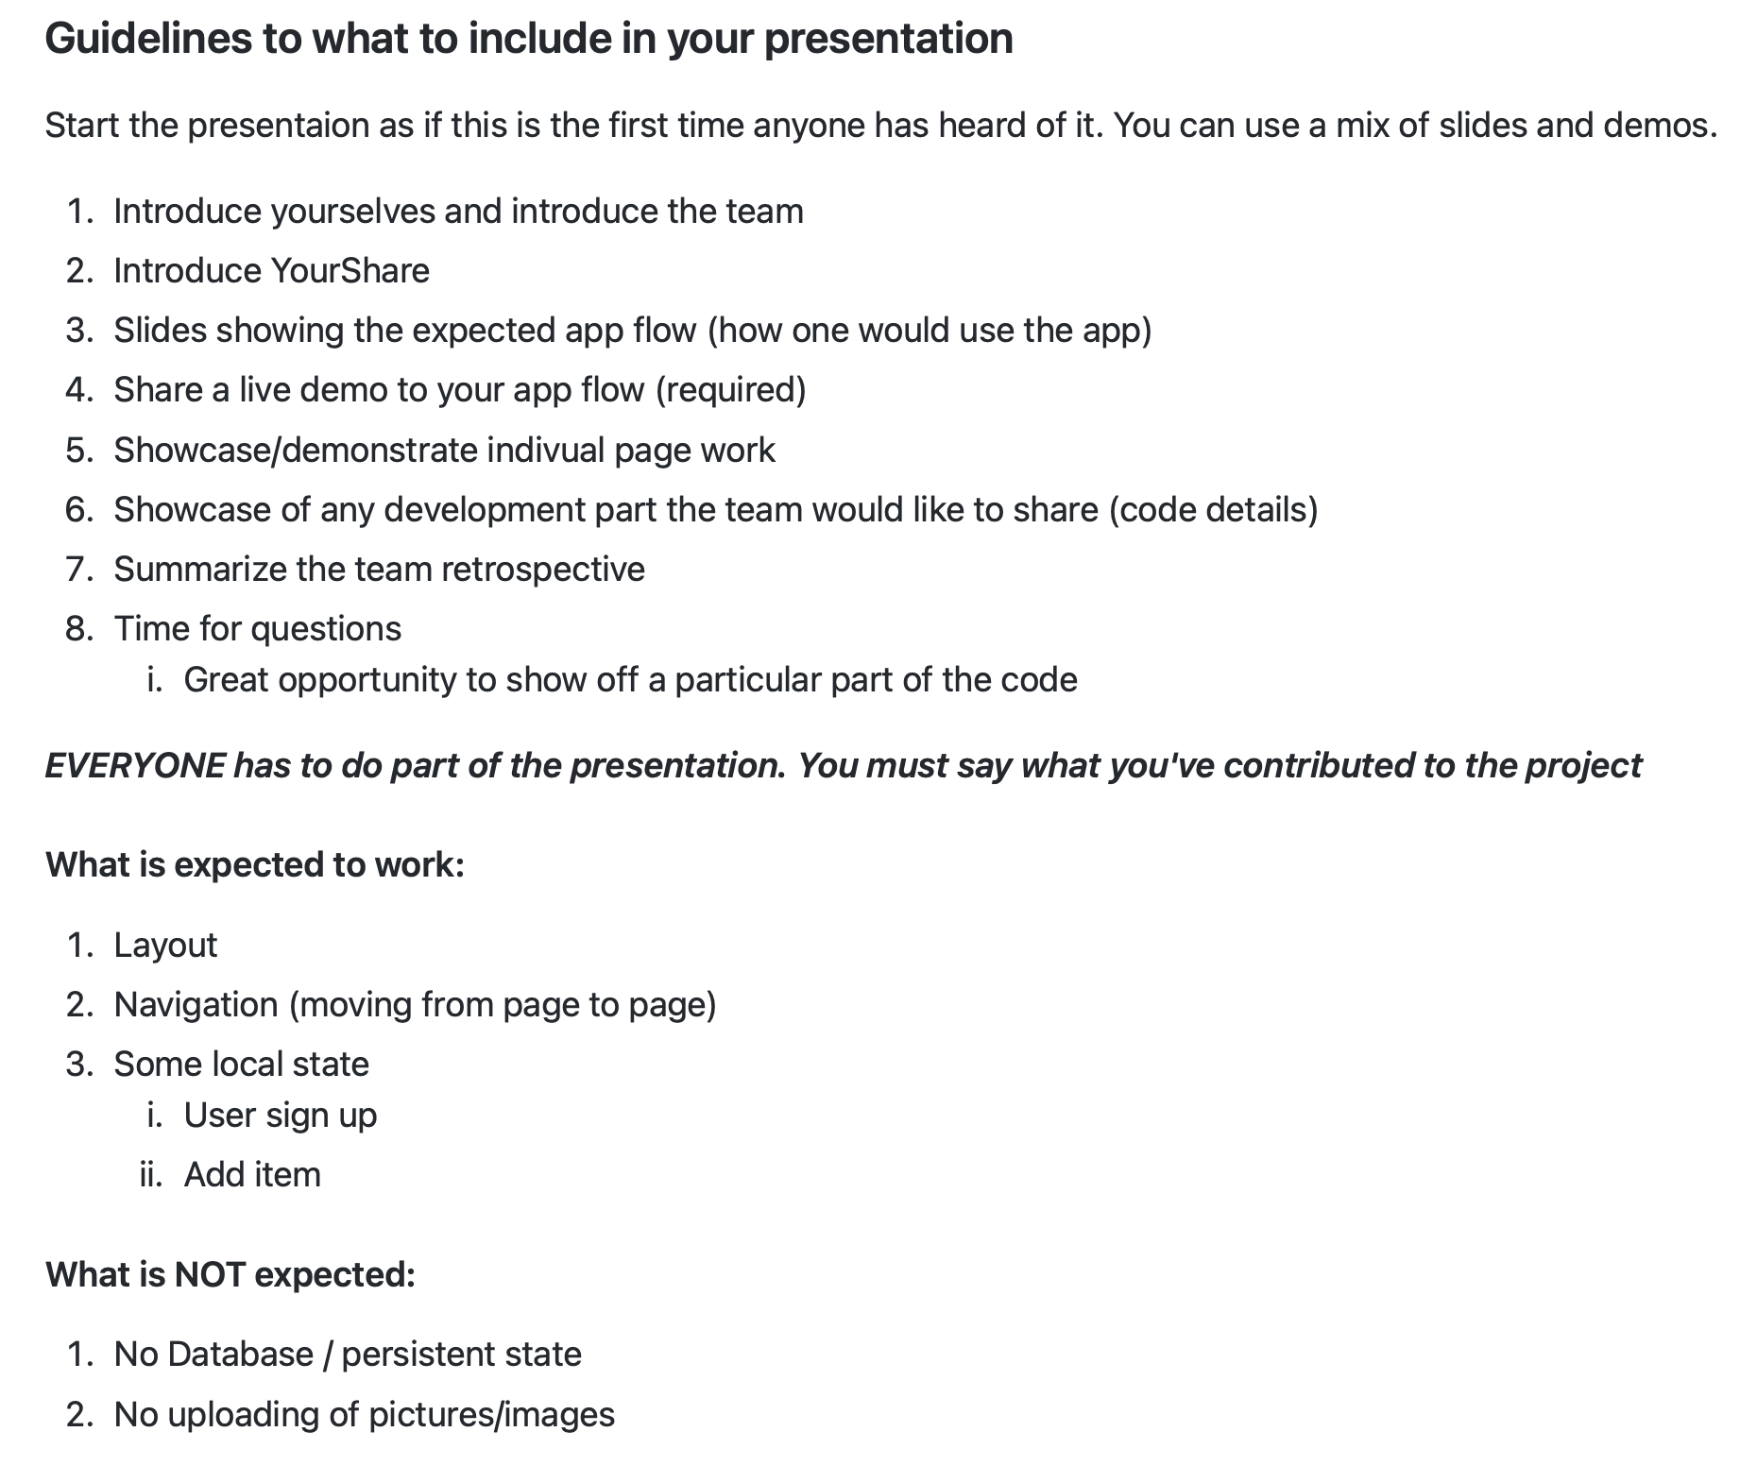
YourShare
10 min presentation
with questions
PowerPoint / Demos

Slide 3
Learning objectives
TNTs will understand what component libraries are
TNTs will write code that demonstrates how to import component libraries into their project, and how to utilize existing components/controls/widgets in their existing project
TNTs will write code that demonstrates how to create and use new, custom components in their existing project

Slide 4
PART 1 COMPONENT LIBRARY

Slide 5
What component libraries did we see so far?

Slide 6
What is a component library?
A component library is a collection of components installed generally through a package manager that provides common solutions whether it's a UI library, testing library, etc.
Why use a component library?
Prebuilt out of the box solutions
Increase speed of delivery
Customization of an application
Allows focus on core application competencies vs boilerplate features

Slide 7
How to choose a component library?
Things to consider before using a component library
Components may become outdated as other technologies advance
Consider the popularity and community activity for the component library
Ease of use generally through an API defined by the component library
Tradeoffs between speed, customization time, cost and immediate business needs

Slide 8
Using library documentation
There is gallery of components that you can explore and choose from
There is a "How to" or “Getting Started” section to quickly get started but may not include details on how to use all the components. This is a good place to start for an overview of the library
Then there are code examples and demos, many of which can be copy-and-pasted (with due citations if required)
Then there are tutorials
Nowadays it's also pretty common to have online demonstrations of the code that you can edit & experiment with in your browser to try out before integrating in your app (e.g., CodePen)

Slide 9
PART 2 THE EXAMPLE OF FluentUI

Slide 10
Documentation on FluentUI
Be careful, the code is in TypeScript in the FluentUi website
You can try this tool to convert TypeScript to JavaScript:
https://extendsclass.com/typescript-to-javascript.html
For FluentUI docs, they show you a bunch of examples
In the example, you will see an 'interface', which is a list of methods, properties, and variables that you can use to customize the component (and/or to respond to user input, etc.)
First, consult Getting started with FluentUI

Slide 11
FluentUI
Fluent UI is a UI component library available in two flavors: Fluent UI React and Fabric Core.
Fluent UI React is a front-end framework designed to build experiences that fit seamlessly into a broad range of Microsoft products. It provides robust, up-to-date, accessible components which are highly customizable using CSS-in-JS.
Fabric Core is an open-source collection of CSS classes and Sass mixins that give you access to colors, animations, fonts, icons and grid.
https://developer.microsoft.com/en-us/fluentui#/
Notes:
SASS syntactically awasome style sheets - CSS with super powers. mature stable and powerful extension of CSS

Slide 12
Setting up FluentUI
Installation
npm install @fluentui/react
Imports
import { [name_of_component] } from '@fluentui/react'
import { Stack } from '@fluentui/react'

Slide 13

FluentUI Button
import { DefaultButton, PrimaryButton } from '@fluentui/react/lib/Button';
<Stack horizontal>
<DefaultButton text="Standard" />
<PrimaryButton text="Primary" />
</Stack>

Slide 14
PART 3 DEMO - DATE PICKER

Slide 15
CODE OF THE SESSION
https://github.com/tnt-summer-academy/Samples/tree/main/Week_3/component-library-fluent

Slide 16
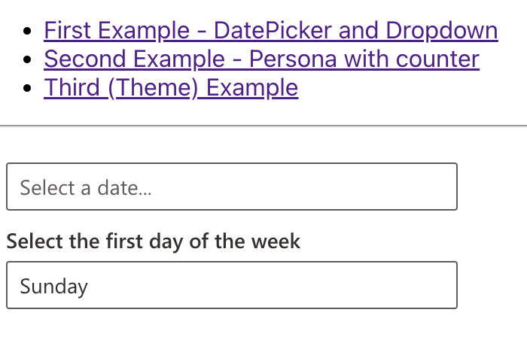
We’ll implement this!

Slide 17
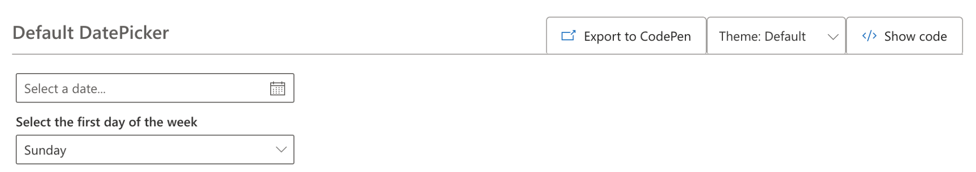
DataPicker
https://developer.microsoft.com/en-us/fluentui#/controls/web/datepicker

Slide 18
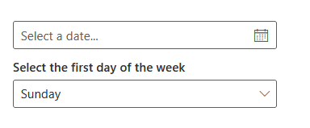
DatePicker
import { DatePicker, DayOfWeek, Dropdown, mergeStyles } from "@fluentui/react";
...
const [firstDayOfWeek, setFirstDayOfWeek] = React.useState(DayOfWeek.Sunday);
const onDropdownChange = React.useCallback((event, option) => {
setFirstDayOfWeek(option.key);}, []);}
...
<DatePicker
firstDayOfWeek={firstDayOfWeek}
placeholder="Select a date..."
ariaLabel="Select a date"
// DatePicker uses English strings by default.
// For localized apps, you must override this prop.
strings={defaultDatePickerStrings}
/>
<Dropdown
label="Select the first day of the week"
options={days}
selectedKey={firstDayOfWeek}
onChange={onDropdownChange}
/>

Slide 19
TypeScript to JavaScript
There may be useful tools to help with this (such as this one), but they tend to produce hard-to-read code, and that particular one doesn't work with JSX.
You can convert the code manually - fundamentally, you paste the code into a .JS file in VSCode, and then delete anything that's underlined in red squiggles that you don't recognize as being part of JS.
Some examples:
Remove anything that follows the ": <DataType>" pattern
Remove the return value from functions ( -> <DataType> )
Remove anything between pointy brackets - < >
Remove the words public or private
Delete anything else that VSCode underlines in red squiggles :)

Slide 20
PART 4 DEMO - PERSONA

Slide 21
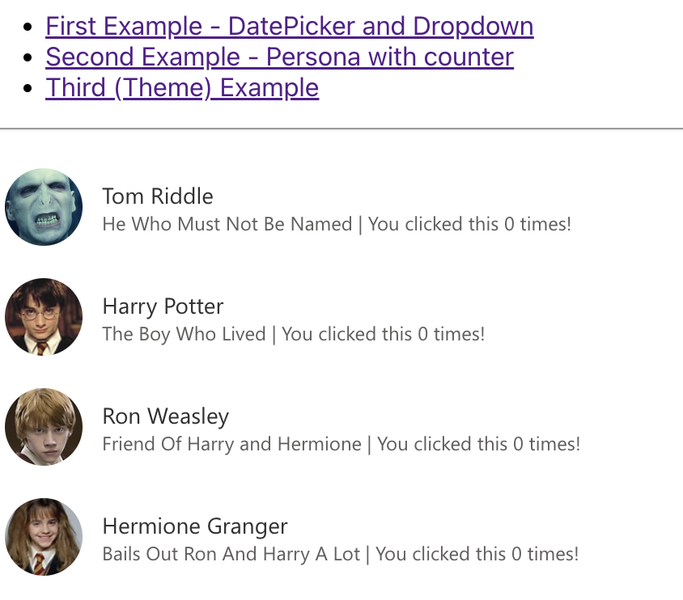
We’ll implement this!

Slide 22
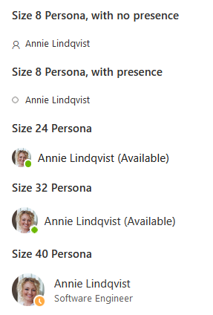
Persona
A persona is a visual representation of a person across products, typically showcasing the image that person has chosen to upload themselves. The control can also be used to show that person's online status.

Slide 23
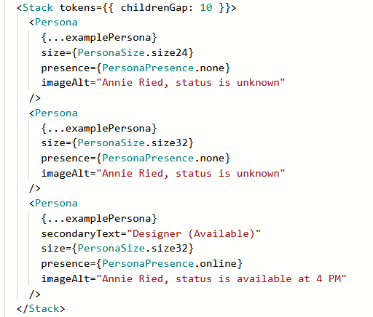
Using Persona
We use a Stack to show a vertical list of Personas

Slide 24
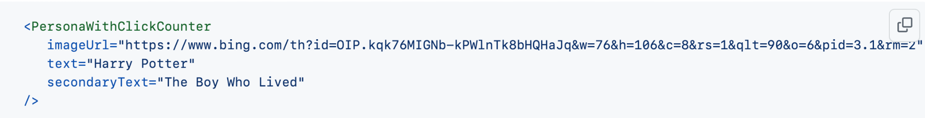
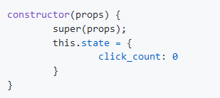
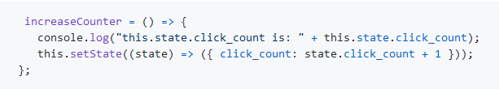

Coding to create our own component
Component: PersonaWithClickCounter
Event handling via the onClick handler

Slide 25
PART 5 STYLING WITH FLUENTUI

Slide 26
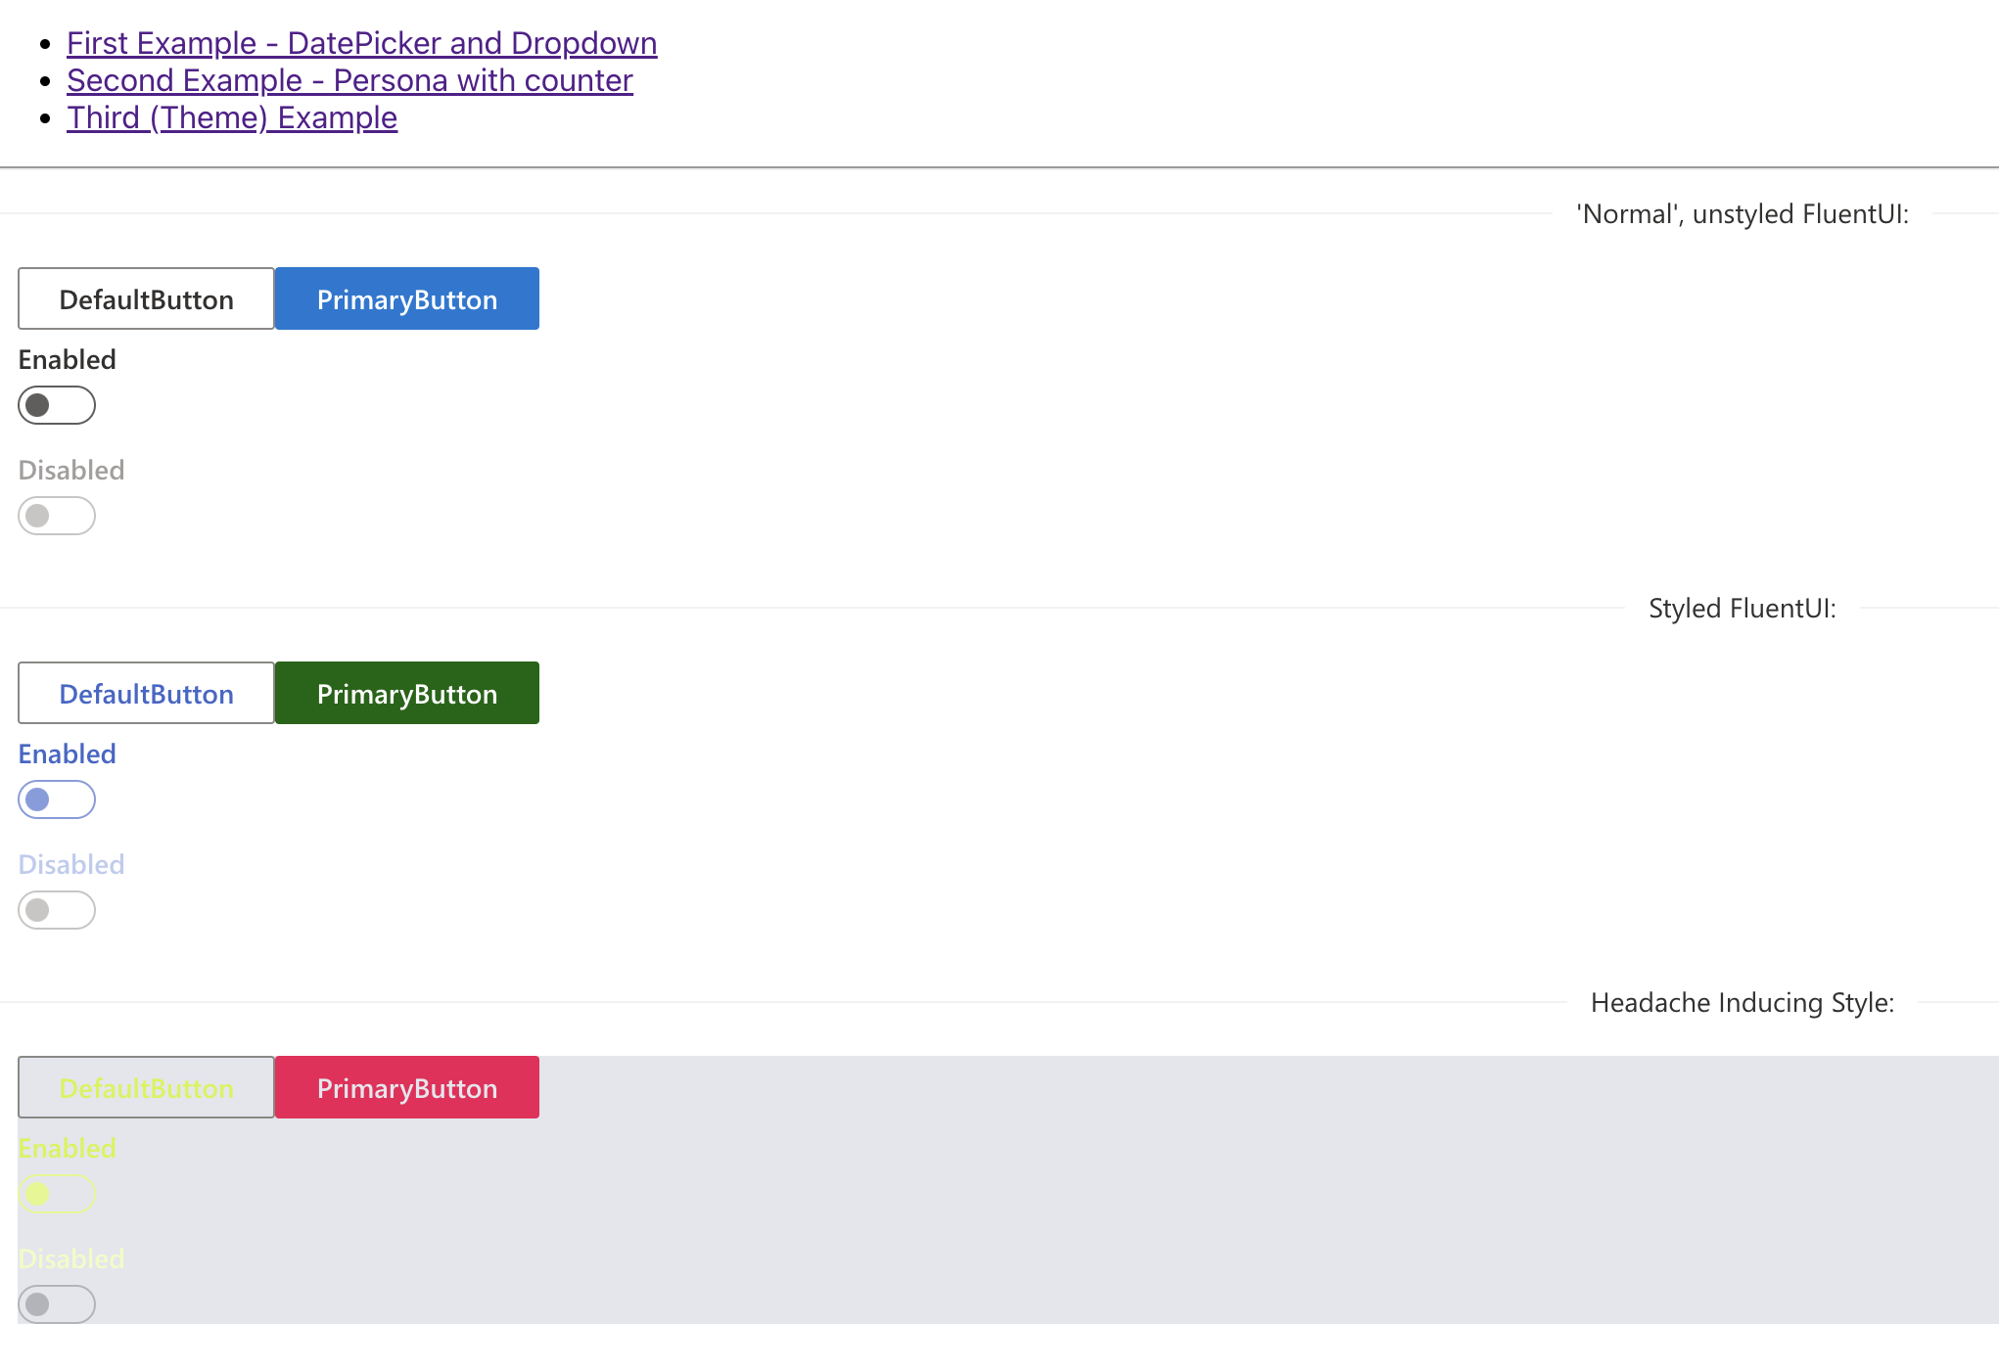
We’ll implement this!

Slide 27
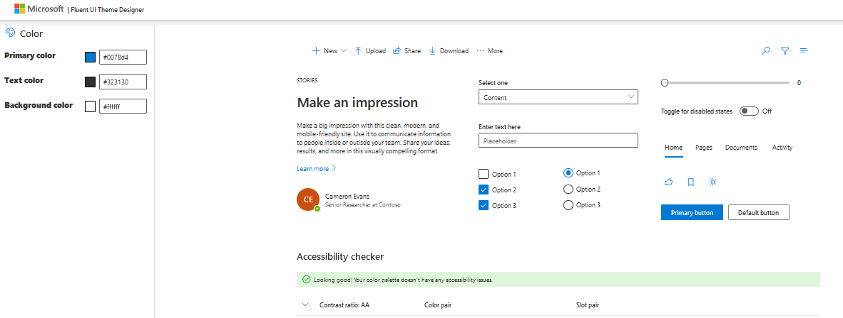
Theme for styling
The documentation of FuentUI includes a theme designer. You can export the theme
https://fluentuipr.z22.web.core.windows.net/heads/master/theming-designer/index.html

Slide 28
const myTheme = createTheme({
palette: {
themePrimary: '#0058d4',
themeLighterAlt: '#f3f7fd',
themeLighter: '#d0e1f8',
themeLight: '#a9c8f2',
themeTertiary: '#5c95e5',
themeSecondary: '#1a6ad9',
themeDarkAlt: '#004fbe',
themeDark: '#0043a1',
themeDarker: '#003177',
neutralLighterAlt: '#f6d8f8',
neutralLighter: '#f2d4f4',
neutralLight: '#e8ccea',
neutralQuaternaryAlt: '#d8beda',
neutralQuaternary: '#ceb5d0',
neutralTertiaryAlt: '#c6aec8',
neutralTertiary: '#a19f9d',
neutralSecondary: '#605e5c',
neutralPrimaryAlt: '#3b3a39',
neutralPrimary: '#323130',
neutralDark: '#201f1e',
black: '#000000',
white: '#fddfff',
}});
<ThemeProvider theme = {myTheme}>
<DefaultButton … />
...
</ThemeProvider>

Slide 29
PART 6 STYLING WITH BOOTSTAP

Slide 30
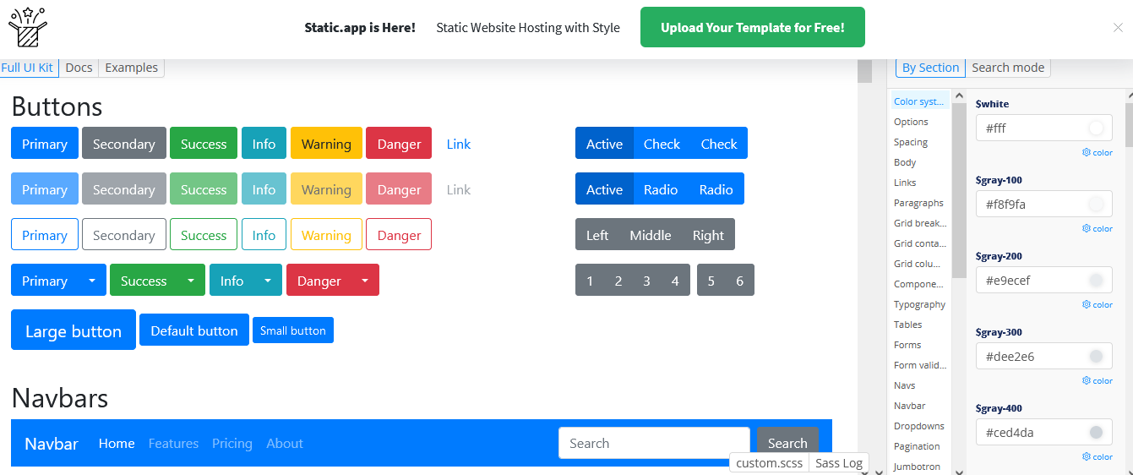
Theme for styling
The documentation of bootstrap includes a theme designer. You can export the theme
https://bootstrap.build/app

Slide 31
PART 7 WORK ON YOURSHARE
Integration first
Then improve

